Slide 1
Lecture 02
Chapter 2
Computer Evolution and Performance

Slide 2
ENIAC - background
Electronic Numerical Integrator And Computer
Eckert and Mauchly
University of Pennsylvania
Trajectory tables for weapons
Started 1943
Finished 1946
  Too late for war effort
Used until 1955

Slide 3
ENIAC - details
Decimal (not binary)
20 accumulators of 10 digits
Programmed manually by switches
18,000 vacuum tubes
30 tons
15,000 square feet
140 kW power consumption
5,000 additions per second

Slide 4
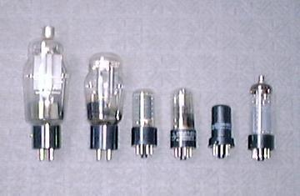
Vacuum tubes

Slide 5
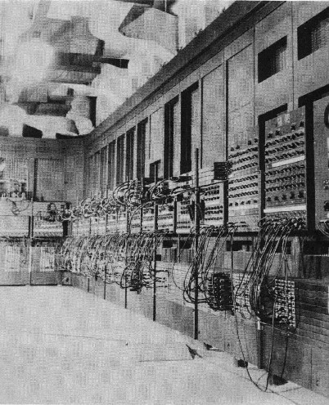
ENIAC

Slide 6
von Neumann/Turing
Stored Program concept
Main memory storing programs and data
ALU operating on binary data
Control unit interpreting instructions from memory and executing
Input and output equipment operated by control unit
Princeton Institute for Advanced Studies
  IAS
Completed 1952

Slide 7
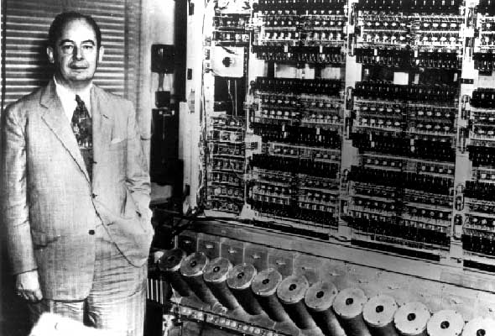
von Neumann
Von Neumann with the first Institute computer

Slide 8
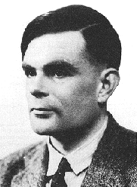
Alan Turing

Slide 9

Structure of von Neumann machine

Slide 10
IAS - details
1000 x 40 bit words
  Binary number
  2 x 20 bit instructions
Set of registers (storage in CPU)
  Memory Buffer Register: Contains a word to be stored in memory or is used to receive a word from memory.
  Memory Address Register: holds the address of a word that moves to/from MBR.
  Instruction Register: Contains the 8-bit opcode instruction being executed.
  Instruction Buffer Register: Holds temporarily the right hand instruction from a word in memory.
  Program Counter: Contains address of the next instruction pair to be fetched from memory.
  Accumulator: Holds one of the operands and results of ALU operations.
  Multiplier Quotient: Hold the least significant 40 bits of multiplying result

Slide 11

Structure of IAS – detail

Slide 12
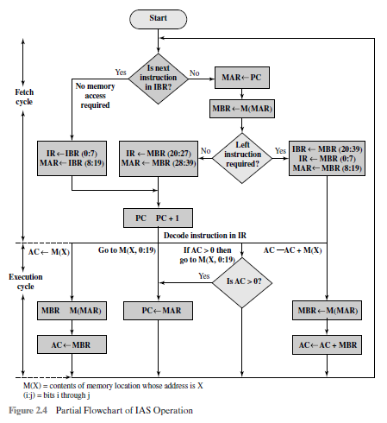
IAS operation: Flowchart(partial)

Slide 13
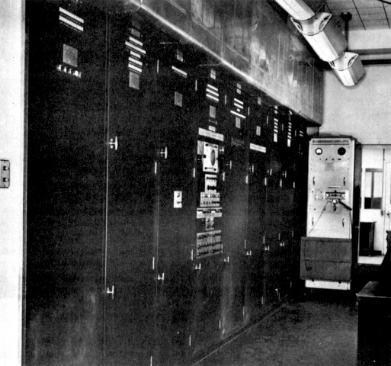
EDVAC- (Electronic Discrete Variable Computer)

Slide 14
Commercial Computers
1947 - Eckert-Mauchly Computer Corporation
UNIVAC I (Universal Automatic Computer)
US Bureau of Census 1950 calculations
Became part of Sperry-Rand Corporation
Late 1950s - UNIVAC II
  Faster
  More memory

Slide 15
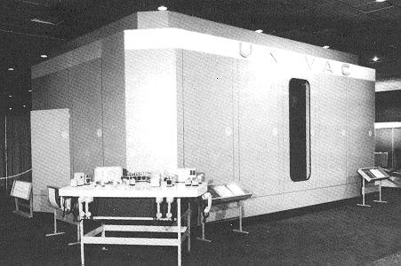
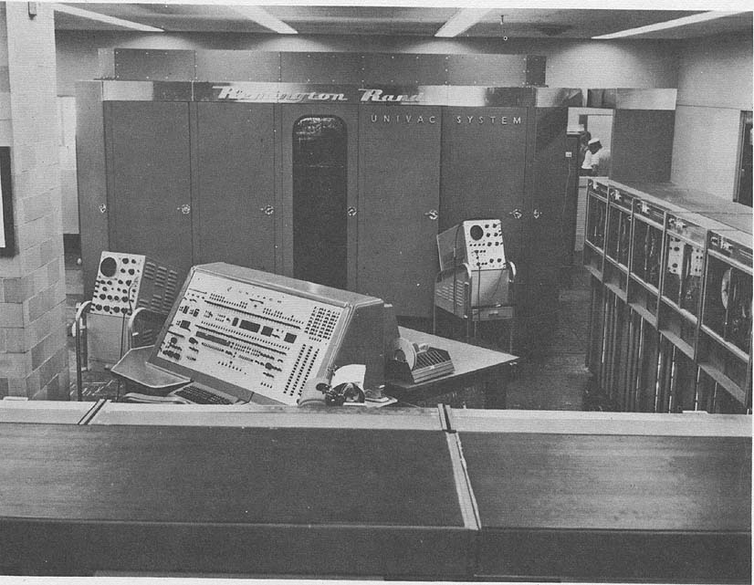
UNIVAC I
UNIVAC II

Slide 16
IBM
Punched-card processing equipment
1953 - the 701
  IBM’s first stored program computer
  Scientific calculations
1955 - the 702
  Business applications
Lead to 700/7000 series that established IBM as the dominant computer manufacturer.

Slide 17
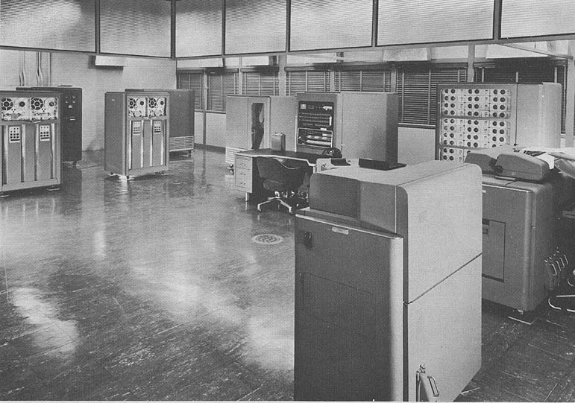
IBM 701

Slide 18
Transistors
Replaced vacuum tubes
Smaller
Cheaper
Less heat dissipation
Solid State device
Made from Silicon (Sand)
Invented 1947 at Bell Labs
William Shockley et al.

Slide 19
Transistor Based Computers
Second generation machines
Electronic equipment was discrete components: transistors, resistors, capacitors and so on.
NCR & RCA produced small transistor machines
IBM 7000
DEC - 1957
  Produced PDP-1
The second generation saw the introduction of more complex arithmetic and logic units and control units, the use of high level programming languages and the provision of system software with the computer.

Slide 20
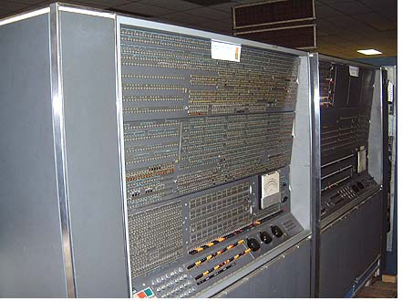
IBM 7030 (1961)

Slide 21
Microelectronics & digital computer
Small electronics and consistent trend towards the reduction in size of electronic circuits.
The basic elements of digital computer must perform storage, movement, processing and control functions.
Two fundamental types of components are required: gates and memory cells. By interconnecting large number of fundamental devices we get a computer.
    Data storage: provided by memory cells
    Data processing: Provided by gates
    Data movement: The path between components are used to move data form memory to memory and from memory through gates to memory
    Control: The path between components carry control signal

Slide 22
Generations of Computer
Vacuum tube - 1946-1957
Transistor - 1958-1964
Small scale integration - 1965 on
  Up to 100 devices on a chip
Medium scale integration - to 1971
  100-3,000 devices on a chip
Large scale integration - 1971-1977
  3,000 - 100,000 devices on a chip
Very large scale integration - 1978 to date
  100,000 - 100,000,000 devices on a chip
Ultra large scale integration
  Over 100,000,000 devices on a chip

Slide 23
Moore’s Law
Increased density of components on chip
Gordon Moore - cofounder of Intel
Number of transistors on a chip will double every year
Since 1970’s development has slowed a little
  Number of transistors doubles every 18 months
Consequences of Moore’s law:
Cost of a chip has remained almost unchanged
Higher packing density means shorter electrical paths, giving higher performance
Smaller size gives increased flexibility
Reduced power and cooling requirements
Fewer interconnections increases reliability

Slide 24
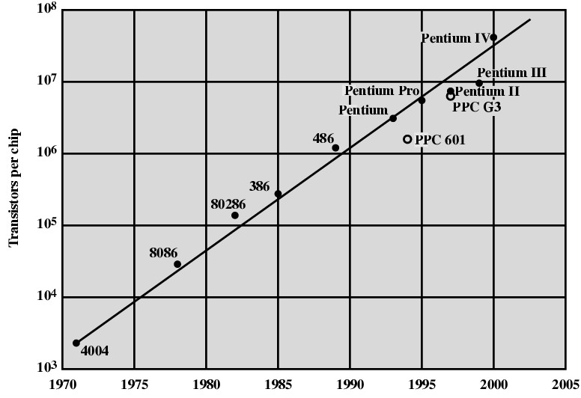
Growth in CPU Transistor Count

Slide 25
IBM 360 series
1964
Replaced (& not compatible with) 7000 series
Ensured market share above 70%
With some modifications and extensions the architecture of the 360 is still the architecture of IBM
First planned “family” of computers
  Similar or identical instruction sets
  Similar or identical O/S
  Increasing speed
  Increasing number of I/O ports (i.e. more terminals)
  Increased memory size
  Increased cost
Multiplexed switch structure

Slide 26
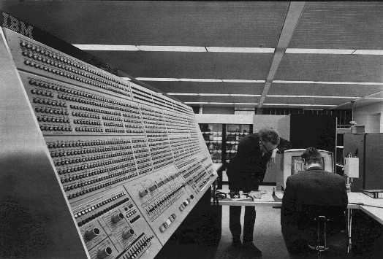
IBM 360 Family

Slide 27
DEC PDP-8
1964
First minicomputer
Did not need air conditioned room
Small enough to sit on a lab bench
$16,000
  $100k+ for IBM 360
Embedded applications
BUS STRUCTURE

Slide 28
DEC - PDP-8 Bus Structure
Console
Controller
Main Memory
I/O
Module
I/O
Module
CPU
OMNIBUS

Slide 29
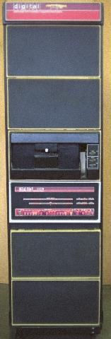
PDP-11 (1973)

Slide 30
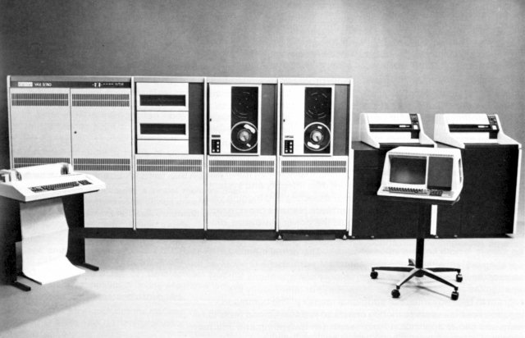
VAX-11 (1981)

Slide 31
Semiconductor Memory
1970
Fairchild
Size of a single core
  i.e. 1 bit of magnetic core storage
Holds 256 bits
Non-destructive read
Much faster than core
Capacity approximately doubles each year
Since 1970 semiconductor memory has been 11 generations: 1K, 4K, 16K, 64K, 256K, 1M, 4M, 16M, 64M, 256M, and now 1G in single chip

Slide 32
Intel
1971 - 4004
  First microprocessor
  All CPU components on a single chip
  4 bit
Followed in 1972 by 8008
  8 bit
  Both designed for specific applications
1974 - 8080
  Intel’s first general purpose microprocessor

Slide 33
Speeding it up
Pipelining
On board cache
On board L1 & L2 cache
Branch prediction
Data flow analysis
Speculative execution

Slide 34
Performance Mismatch
Processor speed increased
Memory capacity increased
Memory speed lags behind processor speed

Slide 35
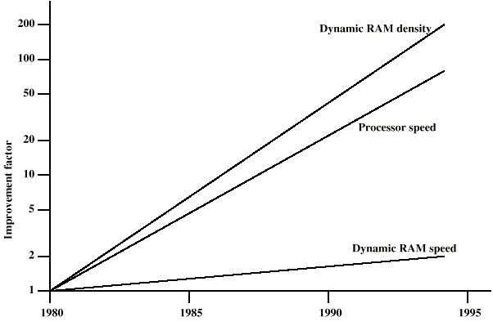
DRAM and Processor Characteristics

Slide 36
Solutions
Increase number of bits retrieved at one time
  Make DRAM “wider” rather than “deeper”
Change DRAM interface
  Cache
Reduce frequency of memory access
  More complex cache and cache on chip
Increase interconnection bandwidth
  High speed buses
  Hierarchy of buses

Slide 37
Pentium Evolution (1)
8080
  first general purpose microprocessor
  8 bit data path
  Used in first personal computer – Altair
8086
  much more powerful
  16 bit
  instruction cache, prefetch few instructions
  8088 (8 bit external bus) used in first IBM PC
80286
  16 Mbyte memory addressable
  up from 1Mb
80386
  32 bit
  Support for multitasking

Slide 38
Pentium Evolution (2)
80486
  sophisticated powerful cache and instruction pipelining
  built in maths co-processor
Pentium
  Superscalar
  Multiple instructions executed in parallel
Pentium Pro
  Increased superscalar organization
  Aggressive register renaming
  branch prediction
  data flow analysis
  speculative execution

Slide 39
Pentium Evolution (3)
Pentium II
  MMX technology
  graphics, video & audio processing
Pentium III
  Additional floating point instructions for 3D graphics
Pentium 4
  Note Arabic rather than Roman numerals
  Further floating point and multimedia enhancements
Itanium
  64 bit
  see chapter 15
See Intel web pages for detailed information on processors

Slide 40
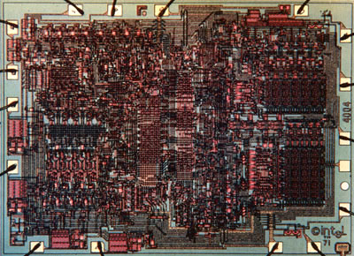
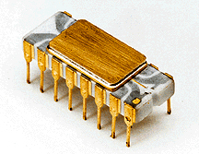
INTEL 4004

Slide 41
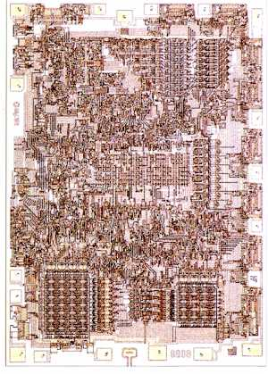

INTEL 8008

Slide 42
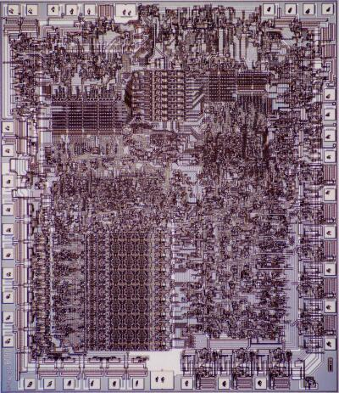
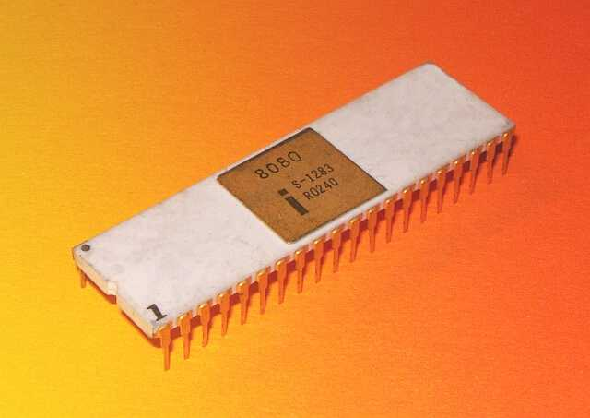
INTEL 8080

Slide 43
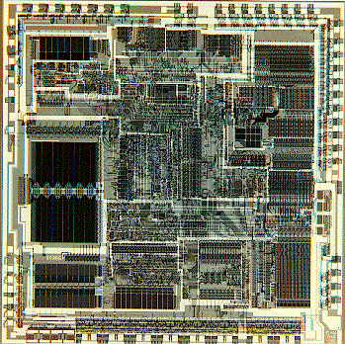

INTEL 80286

Slide 44
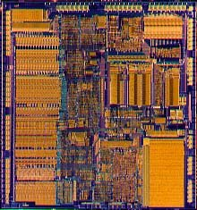
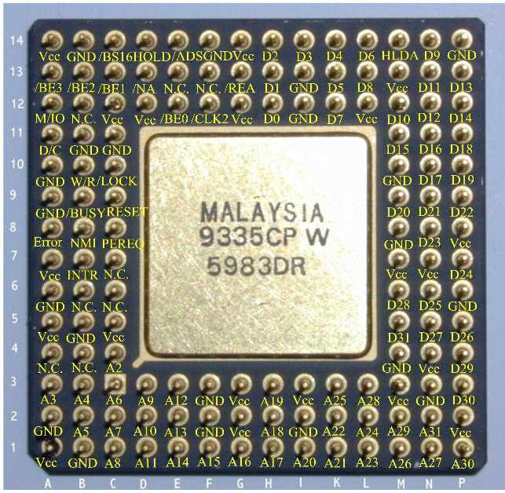
INTEL 80386

Slide 45
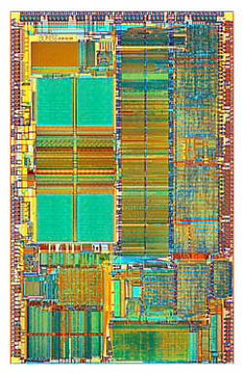
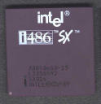
INTEL 80486

Slide 46
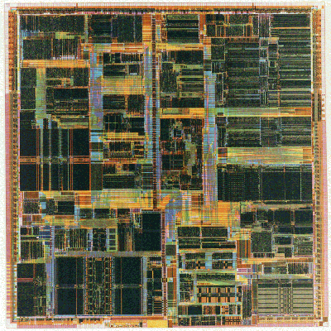
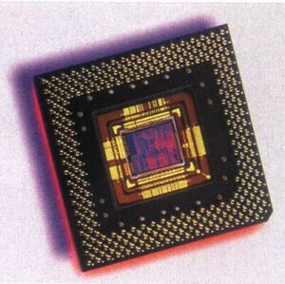
Pentium

Slide 47
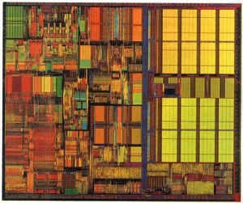
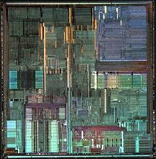
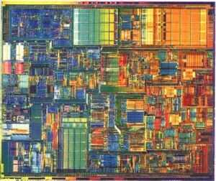
More Pentium
III
Pro
IV

Slide 48
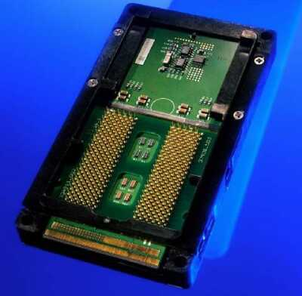
Itanium

Slide 49
Internet Resources
http://www.intel.com/
  Search for the Intel Museum
http://www.ibm.com
http://www.dec.com
PowerPC
Intel Developer Home

